Slide 1
Natural Language Processing DTS305TC
Huakang Li
Huakang.li@xjtlu.edu.cn
School of AI and Advanced Computing
Notes:
English Title: Uppercase, Calibri size 60, XJTLU Navy
English Subtitle: Uppercase, Calibri size 36, XJTLU Navy

Slide 2
Lab 5 Document Retrieval
week 4 day 2
https://spotintelligence.com/2023/10/18/document-retrieval/

Slide 3
Overview
Key concepts
Document Retrieval Systems
Simple Input Interface Sample
Pycharm Sample

Slide 4
Key concepts and components of document retrieval
Document Collection: This document is stored in a database or repository. Records can be of various types, including text documents, web pages, images, videos, and more.
Query: A query is a request for information from the document collection. It’s typically a set of keywords, phrases, or questions a user submits to retrieve relevant documents.
Indexing: To efficiently retrieve documents, an indexing mechanism is used. Indexing involves creating a data structure that maps terms (words or phrases) to the documents where they occur. Standard indexing techniques include inverted indexing, which lists terms with pointers to their locations in documents.
Ranking: Once the relevant documents are identified based on the query and index, a ranking algorithm is used to order them by their relevance to the question. Common ranking algorithms include TF-IDF (Term Frequency-Inverse Document Frequency), BM25, and PageRank (for web search).
Retrieval Models: Different retrieval models, such as Boolean retrieval, vector space models, and probabilistic models, are used to determine which documents are relevant to a given query. These models use various mathematical techniques to assess relevance.

Slide 5
Key concepts and components of document retrieval
Scoring: Documents are scored based on their relevance to the query. Scoring can be found on the frequency of query terms in the documents, their importance, and other factors depending on the retrieval model.
User Interface: In most applications, a user interface allows users to enter queries and see the retrieved documents. Search engines and document management systems provide user-friendly interfaces for this purpose.
Feedback: Some retrieval systems incorporate feedback from users to improve retrieval results. Relevance feedback involves users indicating which documents are relevant or irrelevant, and the system adjusts its retrieval model accordingly.
Relevance Evaluation: Document retrieval systems use metrics like precision, recall, F1 score, and Mean Average Precision (MAP) to assess how well they return relevant documents for a given query.
Performance Optimization: Techniques like caching, distributed indexing, and parallel processing are often used to optimize the performance of document retrieval systems, especially in large-scale applications.

Slide 6
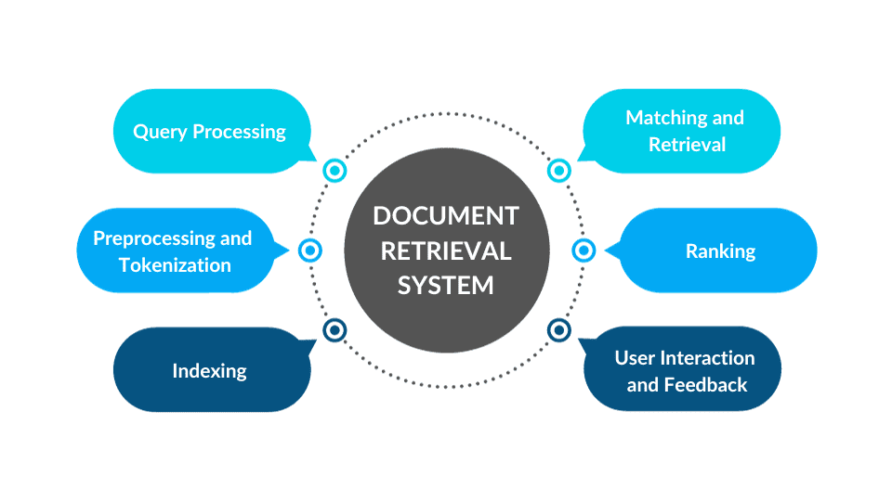
Document Retrieval Systems
Query Processing: The retrieval process starts with the user’s query, a request for specific information. This query is typically entered into a search bar, which can be a single keyword, a phrase, or a complex question. The first step is to process the query to make it suitable for matching with documents in the collection.
Preprocessing and Tokenization: The query is preprocessed, which includes actions such as removing stop words (common words like “and,” “the,” and “in” that don’t add much meaning), stemming (reducing words to their base form), and tokenization (splitting the query into individual words or terms). This standardizes the query and prepares it for matching with documents.
Indexing: Indexing plays a vital role in document retrieval. A document index is a data structure that maps terms to the documents they appear in. The index allows quick and efficient retrieval of documents containing the terms in the user’s query. Various indexing techniques, such as inverted indexing, are used to create this mapping.

Slide 7
Document Retrieval Systems
Matching and Retrieval: Once the query is processed and the index is ready, the retrieval process matches the query terms with the indexed documents. As discussed in the previous section, retrieval models come into play here. Each record in the collection is scored based on its relevance to the query.
Ranking: After the matching phase, documents are ranked based on relevance scores. Documents that are more relevant to the query receive higher rankings. Standard ranking algorithms include TF-IDF, BM25, or machine learning-based models. The top-ranked documents are usually presented to the user.
Presentation to the User: The ranked list of documents is presented to the user, typically in search results. The user interface may display document titles, snippets, and other metadata to help users quickly assess the relevance of each outcome.
User Interaction and Feedback: Users interact with the presented results by clicking on documents or adjusting their queries. This interaction can provide valuable feedback to improve the retrieval system. Many search engines and applications use this feedback to refine the ranking and relevance of documents continuously.
Caching and Optimization: To ensure fast response times, retrieval systems may use caching strategies to store frequently accessed documents or results. Additionally, various optimization techniques, like distributed indexing and parallel processing, are employed to enhance the performance of the retrieval process.

Slide 8
How to build a document retrieval system in Python
1. Data Collection and Preprocessing:
Gather the documents you want to include in your retrieval system. For simplicity, you can start with a small collection of text documents. Organize your data into a structured format (e.g., a list of dictionaries) with document IDs and text content.
Preprocess your documents by tokenizing the text, removing stop words, and performing stemming or lemmatization if needed. You can use libraries like NLTK or spaCy for text processing.
2. Indexing:
Create an inverted index to map terms to their document IDs. This index will allow for efficient retrieval of documents during searches. You can use Python dictionaries or custom data structures for this purpose.
inverted_index = {} # Initialize an empty inverted index
# Populate the inverted index
for doc_id, document_text in documents:
terms = preprocess(document_text)
for term in terms:
if term not in inverted_index:
inverted_index[term] = set()
inverted_index[term].add(doc_id)

Slide 9
How to build a document retrieval system in Python
3. Retrieval Model:
Choose a retrieval model that suits your needs. For simplicity, you can start with a basic vector space model. Calculate document and query vectors using techniques like TF-IDF and cosine similarity.
4. Query Processing:
Implement a simple query processing function that tokenizes and preprocesses user queries. This function should return a list of relevant document IDs based on the query.
5. Scoring and Ranking:
Calculate relevance scores for the documents in the result set using your chosen retrieval model. You can sort the records by their relevance scores to rank them.
def process_query(query):
query_terms = preprocess(query)
relevant_docs = set()
for term in query_terms:
if term in inverted_index:
relevant_docs.update(inverted_index[term])
return list(relevant_docs)

Slide 10
How to build a document retrieval system in Python
6. User Interface:
For a simple command-line interface, prompt the user to enter a query, process the query, and display the ranked list of documents. For more advanced interfaces, you can use libraries like Flask or Django to create a web-based user interface.
7. Testing and Evaluation:
Test your retrieval system with various queries to ensure it returns relevant results. Use evaluation metrics like precision and recall to assess the system’s performance.
8. Optimization and Scaling:
As your document collection grows, you may need to optimize your retrieval system for performance and scalability. Techniques like distributed indexing and caching can be employed.
9. Continuous Improvement:
Gather user feedback and usage data to refine your retrieval system and enhance its relevance.

Slide 11
demo 1
The following is a Python demo of a document retrieval system.
The system has a simple input interface, and the backend reads the content column of a CSV file as the body of the retrieval.
Users can search by entering English keywords or sentences through the interface, and the system will provide the top 10 sorted content contents, and mark the hit keywords and overall search scores on the display page.
During the display process, the headings column serves as the name for each document.

Slide 12
import streamlit as st
import pandas as pd
from sklearn.feature_extraction.text import TfidfVectorizer
from sklearn.metrics.pairwise import cosine_similarity
import numpy as np
import re
# read csv file, with the ‘content’ and ‘headlines’ column
file_path = 'business_data.csv'
df = pd.read_csv(file_path)
# calculate the TF-IDF
vectorizer = TfidfVectorizer(stop_words='english')
X = vectorizer.fit_transform(df['content'])
# set Streamlit page title
st.title("Document Retrieval System")
# user query keywords or sentence
user_input = st.text_input("Enter your search query (English):")
if user_input:
# vectorize user input
query_vec = vectorizer.transform([user_input])
# calculate the cosine value between input and document
similarity_scores = cosine_similarity(query_vec, X).flatten()
# sort top 10 documents
top_n_indices = np.argsort(similarity_scores)[::-1][:10]
# display 10 documents
st.subheader("Top 10 Retrieved Documents:")
for idx in top_n_indices:
content = df['content'].iloc[idx]
headline = df['headlines'].iloc[idx] # headlines as document name
score = similarity_scores[idx]
# highlight keywords
highlighted_content = re.sub(rf"(?i)({user_input})", r'**\1**', content)
st.markdown(f"**Headline: {headline}**")
st.markdown(f"**Relevance Score:** {score:.4f}")
st.markdown(highlighted_content)
st.markdown("---")

Slide 13
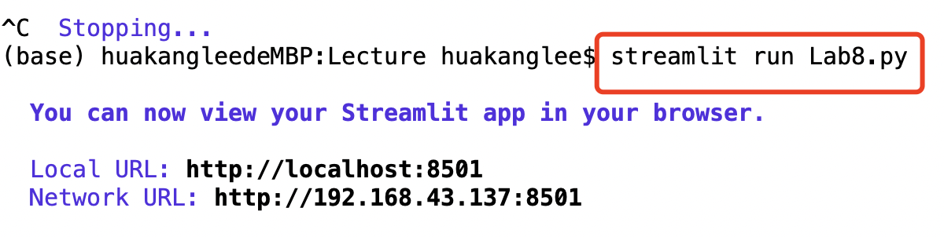
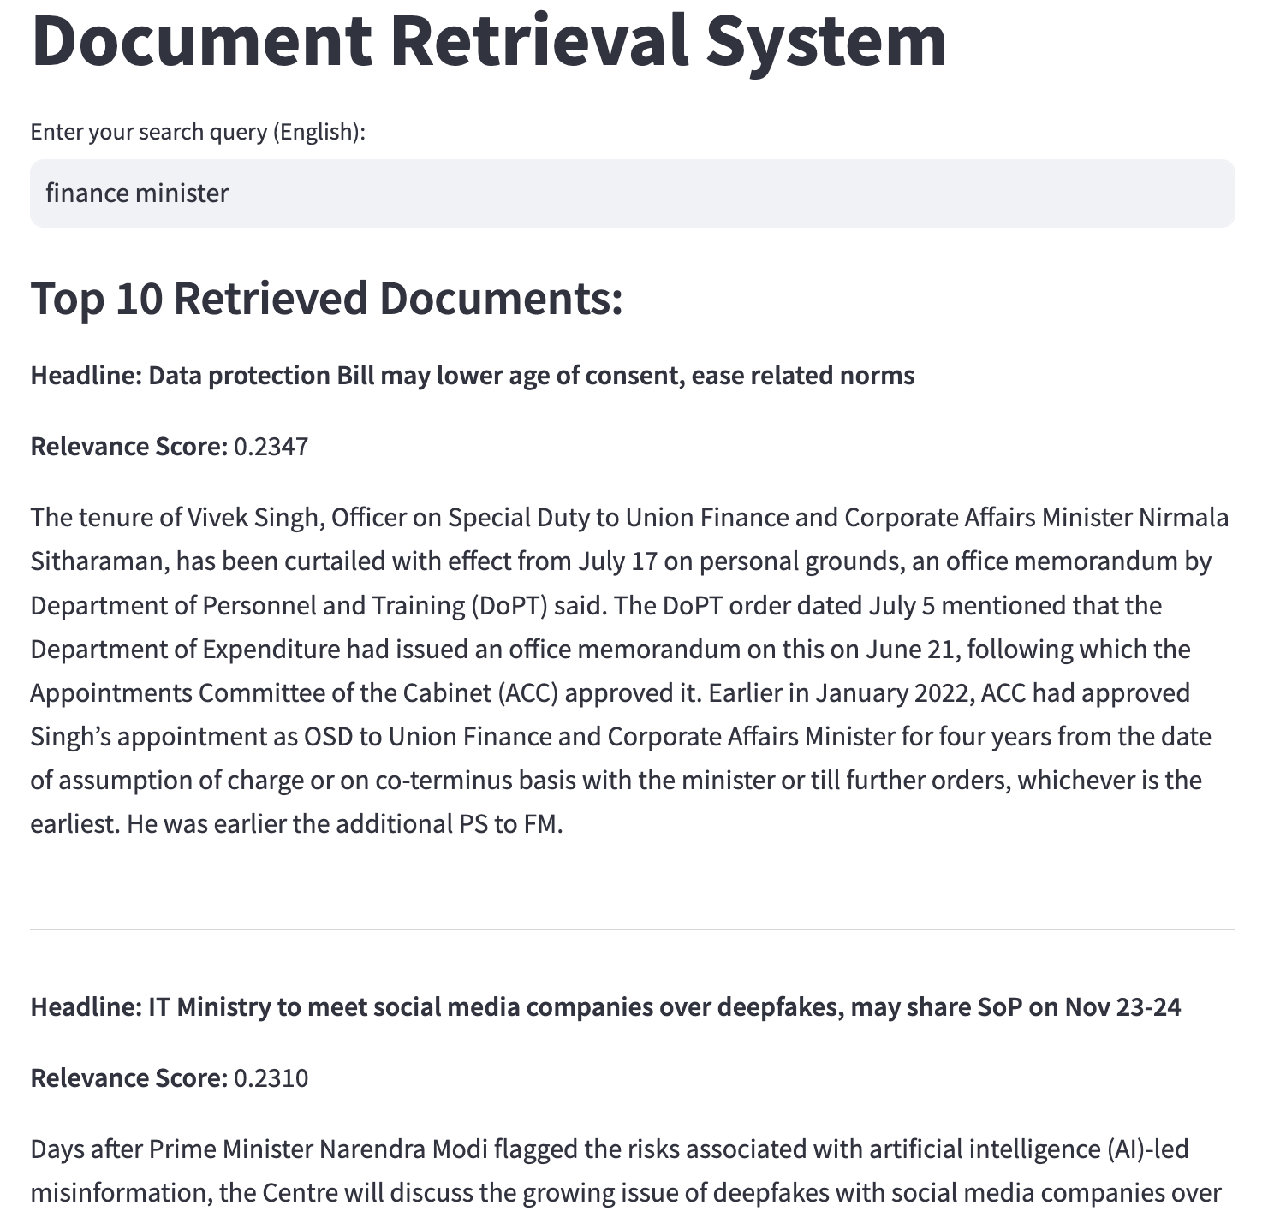
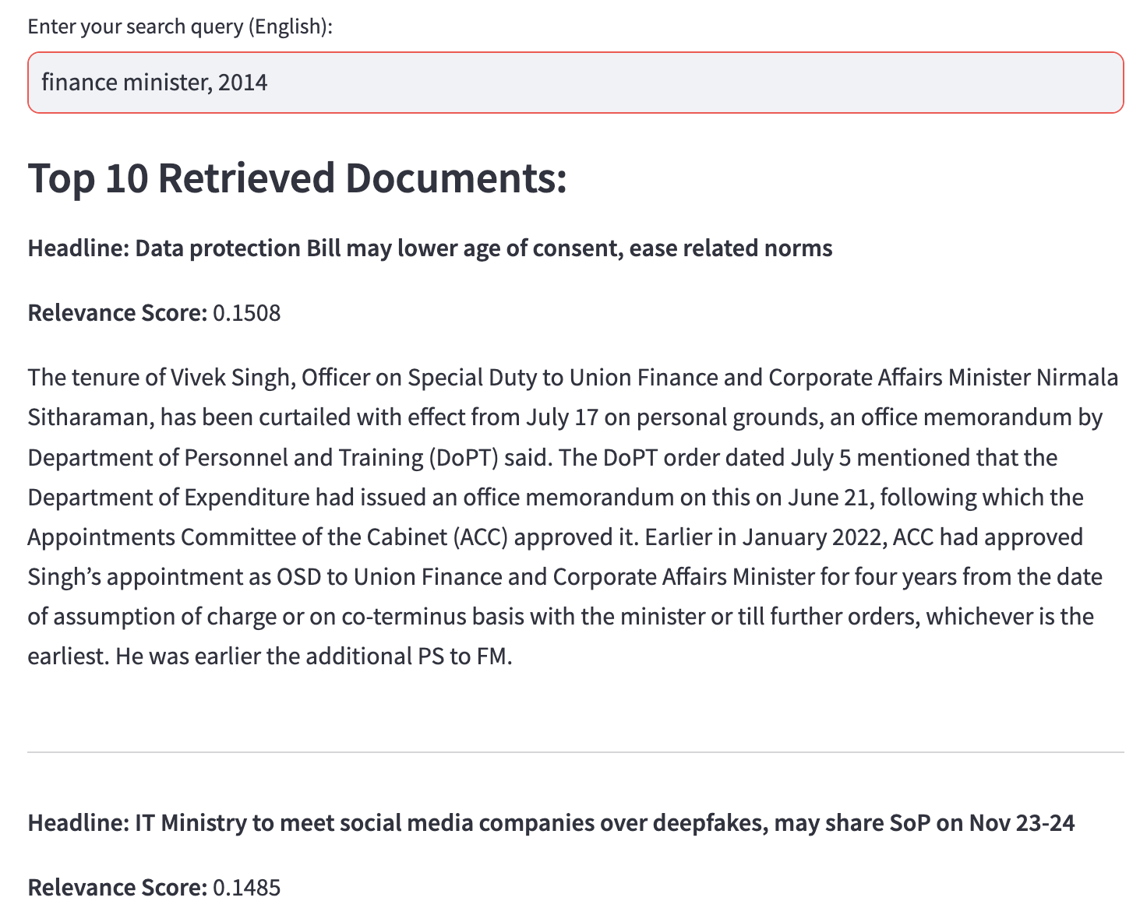

Slide 14
demo 2
Create a demo of a document retrieval system using pycharm.
Users can directly input search content in the PyCharm runtime environment.
The backend reads the contents of the headings and content columns in a CSV file as the body of the retrieval.
The weight of the headline as a document title is twice that of the content body.
The system provides the top 10 sorted contents and uses the headline as the title of the document.

Slide 15
import pandas as pd
from sklearn.feature_extraction.text import TfidfVectorizer
from sklearn.metrics.pairwise import cosine_similarity
import numpy as np
import re
file_path = 'business_data.csv'
df = pd.read_csv(file_path)
title_weight = 2
content_weight = 1
combined_text = df['headlines'] + " " + df['content']
vectorizer = TfidfVectorizer(stop_words='english')
X_combined = vectorizer.fit_transform(combined_text)
user_input = input("Enter your search query (English): ")
query_vec = vectorizer.transform([user_input])
similarity_scores = cosine_similarity(query_vec, X_combined).flatten()
top_n_indices = np.argsort(similarity_scores)[::-1][:10]
print("\nTop 10 Retrieved Documents:\n")
for idx in top_n_indices:
content = df['content'].iloc[idx]
headline = df['headlines'].iloc[idx]
score = similarity_scores[idx]
highlighted_content = re.sub(rf"(?i)({user_input})", r'**\1**', content)
print(f"Headline: {headline}")
print(f"Relevance Score: {score:.4f}")
print(f"Content: {highlighted_content}")
print("---")

Slide 16
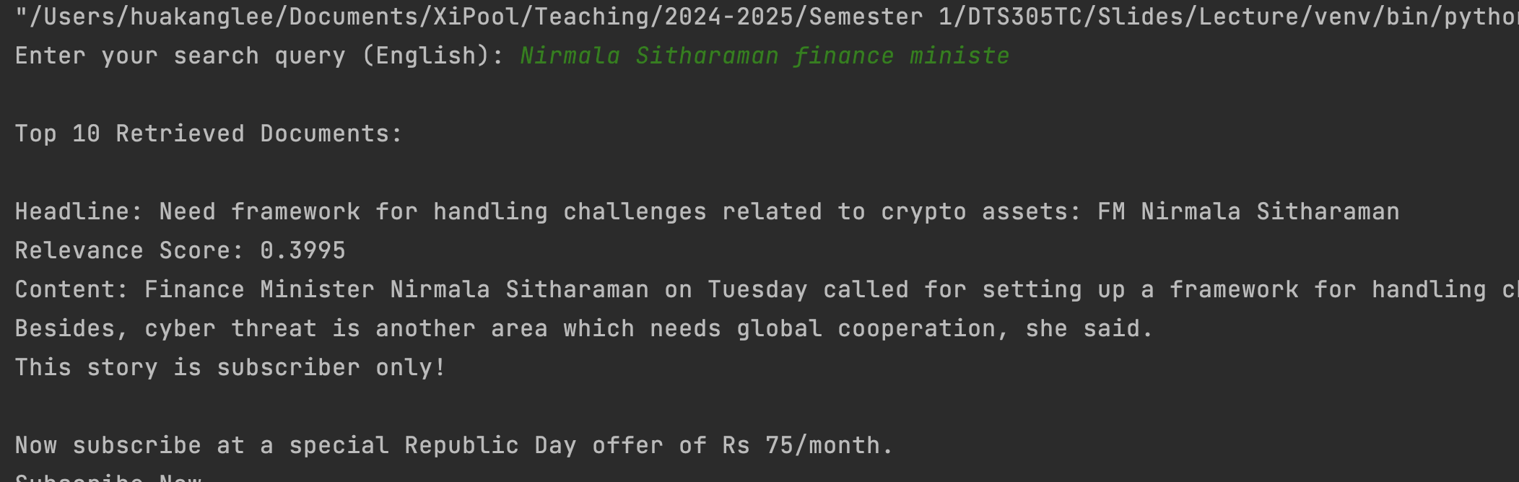

Slide 17
Exercises 1
Please use Python to implement an information retrieval system.
The system can read all files in a folder as the search scope.
Users input search keywords through the interface.
The system provides the top 10 as search results and displays paragraphs that match the file name and keywords instead of the full text.

Slide 18
Exercises 2
Please use Python to implement an information retrieval system.
The system is capable of reading a CSV file and using the content and title columns as the search body.
Prioritize matching titles during the retrieval process.
The search results only need to provide relevant sentences, titles, and matching degrees that match.

Slide 19



THANK YOU
Visit us
FOLLOW us
www.xjtlu.edu.cn
Notes:
Title: Uppercase, Calibri size 60, XJTLU Navy

